Slide 1
Team “Pay to Play”
Group members:
Dino Molina
Robert Oppan
Kevin Williamson

Slide 2

Motivation & Summary
NOTE:
To change images on this slide, select a picture and delete it. Then click the Insert Picture icon
in the placeholder to insert your own image.
NBA players are highly paid in today’s league. We wanted to determine based 2017-2018 player statistics, is it worth paying NBA players top dollar.

Slide 3
Fun Fact
NOTE:
To change images on this slide, select a picture and delete it. Then click the Insert Picture icon
in the placeholder to insert your own image.
The highest NBA player salary in 2017-2018 was Golden State Warriors guard Steph Curry at $34,682,550. The Warriors team salary was $42,363,018 in 2000-2001.

Slide 4
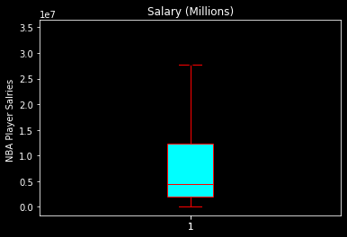
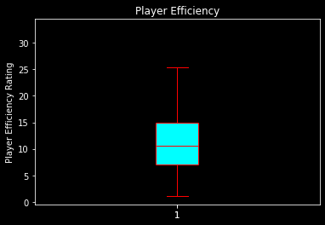
Key Stats
Average NBA salaries: ~ $7,900,000
Top 25% Salaries: ~ $12,300,000 & above
Bottom 25% Salaries: ~ $1,900,00 & below
Average Player Efficiency Rating (PER): ~ 11.67
Top 25% PER: ~ 14.9
Bottom 25% PER: ~ 7.1

Slide 5
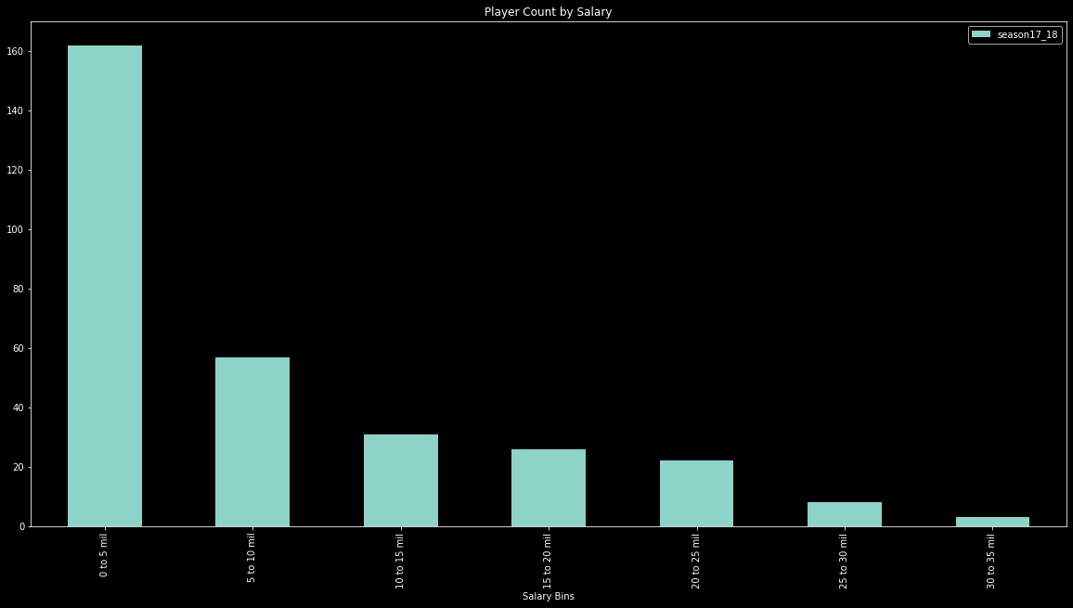
Salary Distribution
In the 2017-2018 season the majority of NBA players were paid between $0 – 5mil
Very few players make above $20mil

Slide 6
Question 1 – How do we measure a player’s performance against their peers?
Based on our research players are measured using a player efficiency rating
Points + Rebound + Assist + Steals + Blocks – Missed Field Goals – Missed Free Throws – Turnovers / Games Played = Player Efficiency Rating (PER)
Once their PER was calculated we compared it to their salaries

Slide 7
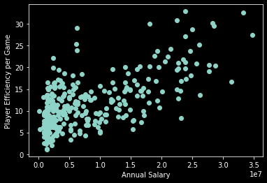
Findings
Players with a PER of ~20 are paid higher than average
Salaries vary greatly with a PER under ~20

Slide 8
Top 20 Highest Paid Players
# | Player | Salary (mil.) | PER
1 | Stephen Curry | 34,682,550 | 27.5
2 | LeBron James | 33,285,709 | 32.7
3 | Paul Millsap | 31,269,231 | 16.7
4 | Kyle Lowry | 28,703,704 | 20.4
5 | Russell Westbrook | 28,530,608 | 29.6
6 | James Harden | 28,299,399 | 30.2
7 | DeMar DeRozan | 27,739,975 | 20.5
8 | Al Horford | 27,734,405 | 19.1
9 | Carmelo Anthony | 26,243,760 | 13.7
10 | Damian Lillard | 26,153,057 | 25.2
11 | Jrue Holiday | 25,686,667 | 20.8
12 | Kevin Durant | 25,000,000 | 28.8
13 | Otto Porter | 24,773,250 | 18.1
14 | Chris Paul | 24,599,495 | 23.8
15 | C.J. McCollum | 23,962,573 | 17.4
16 | Anthony Davis | 23,775,506 | 32.9
17 | Bradley Beal | 23,775,506 | 19.8
18 | Andre Drummond | 23,775,506 | 27.2
19 | Hassan Whiteside | 23,775,506 | 21.2
20 | Dwight Howard | 23,500,000 | 21.9
For the most part top salary players are holding their end of the bargain
20% of the Top 20 % are underperforming:
Paul Millsap
Carmelo Anthony
C.J. McCollum
Otto Porter
Average PER: 23.4

Slide 9
Top Players at a Bargain
# | Player | Salary (mil.) | PER
1 | Lou Williams | 7,000,000 | 18.5
2 | Karl-Anthony Towns | 6,216,840 | 29.1
3 | Ben Simmons | 6,168,840 | 23.9
4 | Joel Embiid | 6,100,266 | 25.4
5 | Aaron Gordon | 5,504,420 | 18.2
6 | Julius Randle | 4,149,242 | 18.7
7 | Tyreke Evans | 3,290,000 | 19.4
8 | Clint Capela | 2,334,520 | 22.2
9 | Devin Booker | 2,319,360 | 19.9
3 players outperforming PER of the Top 20 Highest Paid Players:
Karl-Anthony Towns
Ben Simmons
Joel Embiid

Slide 10
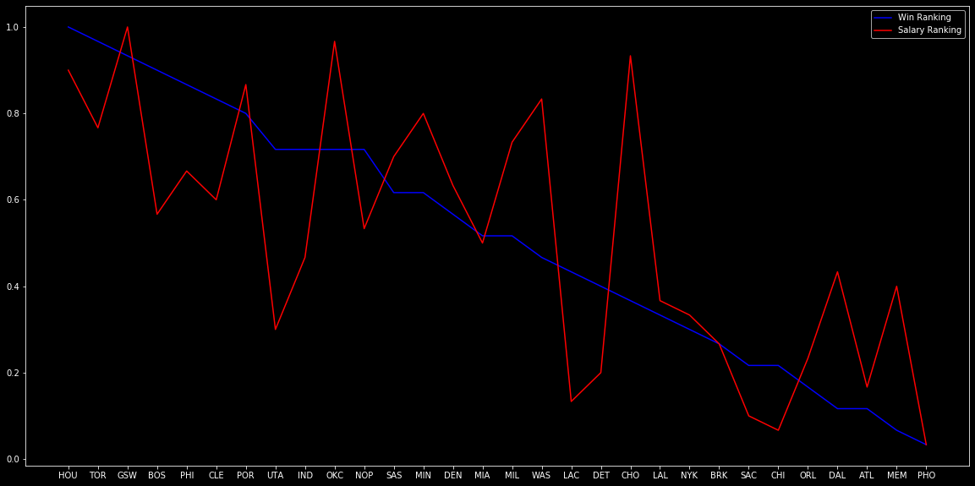
Question 2 – Is there a correlation between the play of highly paid players and team wins?
Based on wins and salary rankings there is no strong correlation between wins and salary
Boston, Cleveland, and Utah have generated more wins with lower salaries
Washington and Charlotte have high payrolls with underperforming results

Slide 11
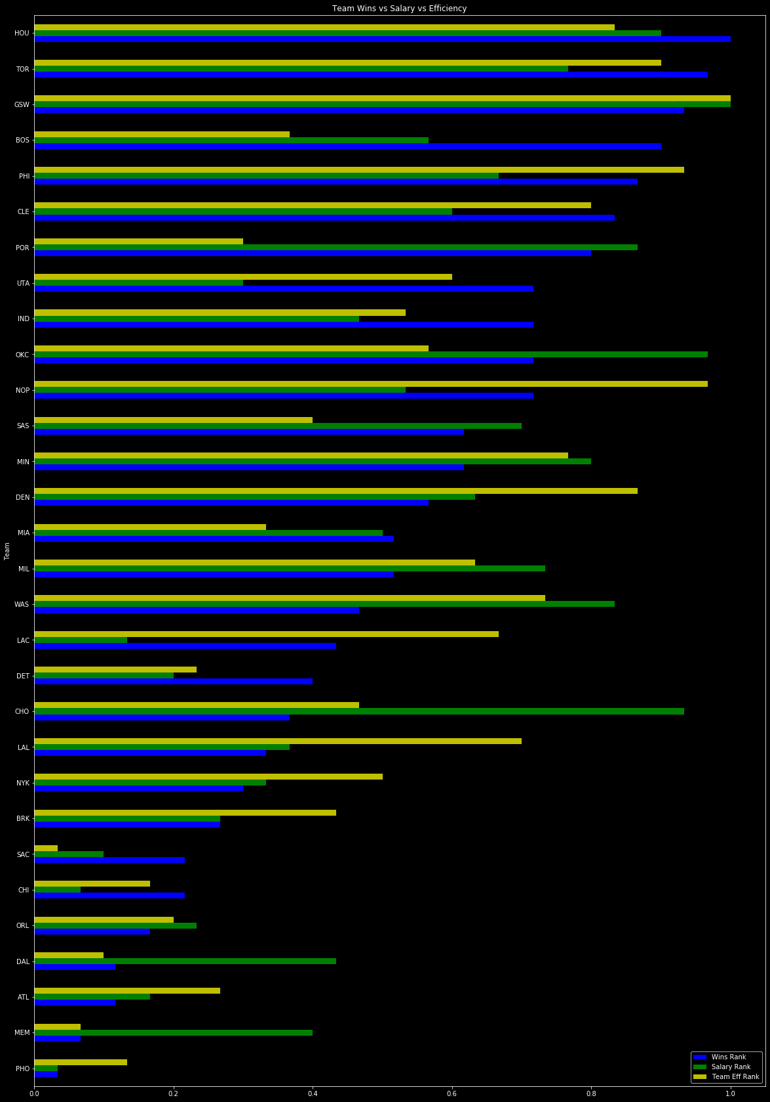
Question 3 – What’s the relationship between wins, salary, and performance?
For the most part, teams that do not carry high salaries also do not have players with high PER
Outliers once again are Charlotte and Washington

Slide 12
Data Cleanup
Compared multiple data sources and what could be obstacles that would prevent us merging the data
Names
Suffixes (Tim Hardaway Jr. to Tim Hardaway)
Symbols in names ( CJ to C.J., Jokić to Jokic )
Ruled out bottom quartile games played (Player needed to play a minimum of 30 games)
Help mitigate the analysis of injured players and benchwarmers
Help eliminate elite / expensive players who did not impact a considerable percentage of games

Slide 13
Data Problems
Appended an abbreviated team label via excel manipulation
Quick method for this dataset
Planned on leveraging ESPN API for data, which included calculated player rating to leverage
Public sharing of API discontinued (August 26, 2014)

Slide 14
Data Analysis
Determining what games played cut off should be
Groupby functions helped with multiple analysis to determine useful and unusable data sets
Ranking Team Wins, Salary, and PER
Provided a consistent scale that allowed us to put all three variables on the same graph
Gathered stats on the individual player
Averages
Quartile ranges
Identify outliers

Slide 15
Discussion
NBA Players with a PER of ~ 20 or above have much higher leverage when negotiating salaries than their sub PER 20 peers.
Due to some players outperforming their peers, we recommend they demand an incentivized contract
i.e. Karl Anthony Towns, Joel Embiid
Higher efficiency performance players also influenced wins
i.e. Karl Anthony Towns was responsible for 21.2% of the Minnesota Timberwolves’ efficiency

Slide 16
Post Mortem
Given more time:
Examine pre/post contract performance amongst veteran players
Do players experience a spike in performance during the last year of their current contract?
Do players live up to the contract increase from a performance perspective?
Study multi year trends for players and teams
Trends in performance decline tolerance among NBA rosters
Sustained excellence trends amongst the lower salary ranked teams with high efficiency

Slide 17
Data Sources
2017-18 NBA Player Stats: Per Game | Basketball-Reference.com
https://www.kaggle.com/mharvnek/nba-team-stats-00-to-18

